Slide 1
Kiran Gavini*(16227237)

Slide 2
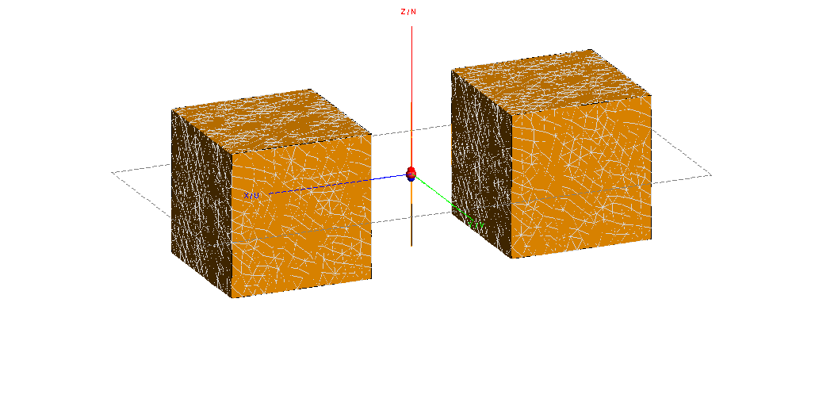
dipole in presence of two PEC cube. when dipole is in middle. size of cube is lambda/2xlambda/2xlambda/2 Placement of two cubes at a distance of lambda/2 from the center of dipole to center of cube

Slide 3
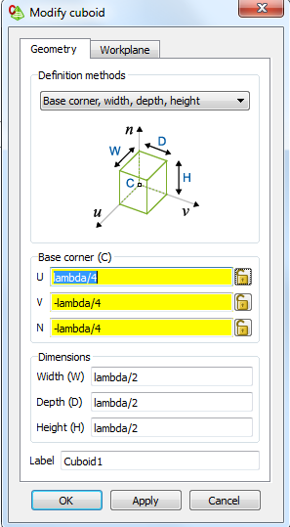
Taking coordinates to position cubes on either sides:

Slide 4
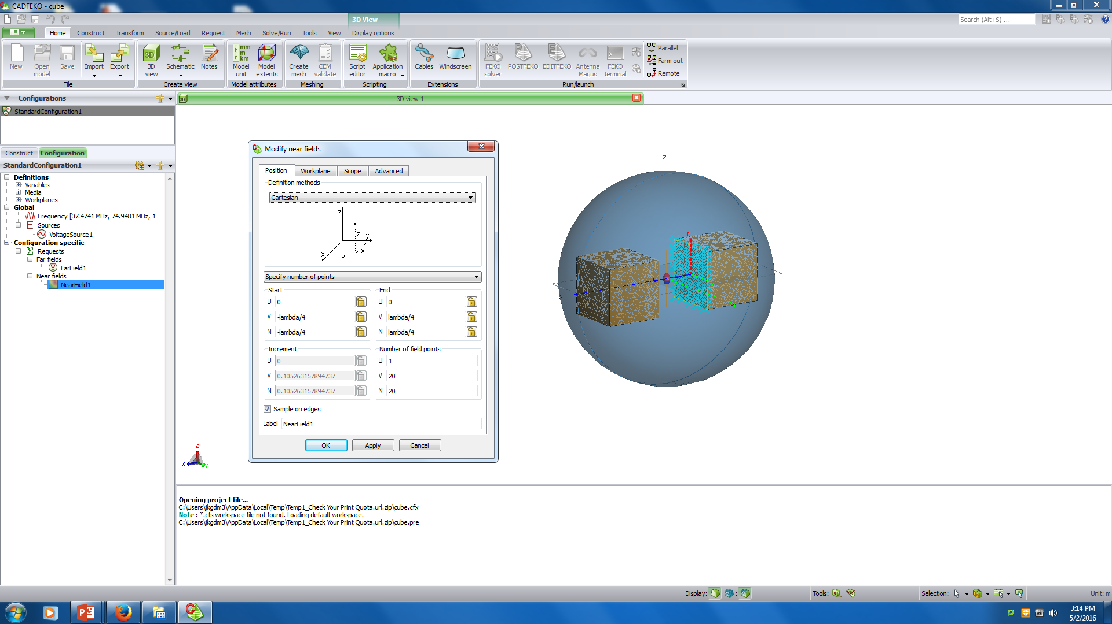
Near field adjustment:

Slide 5
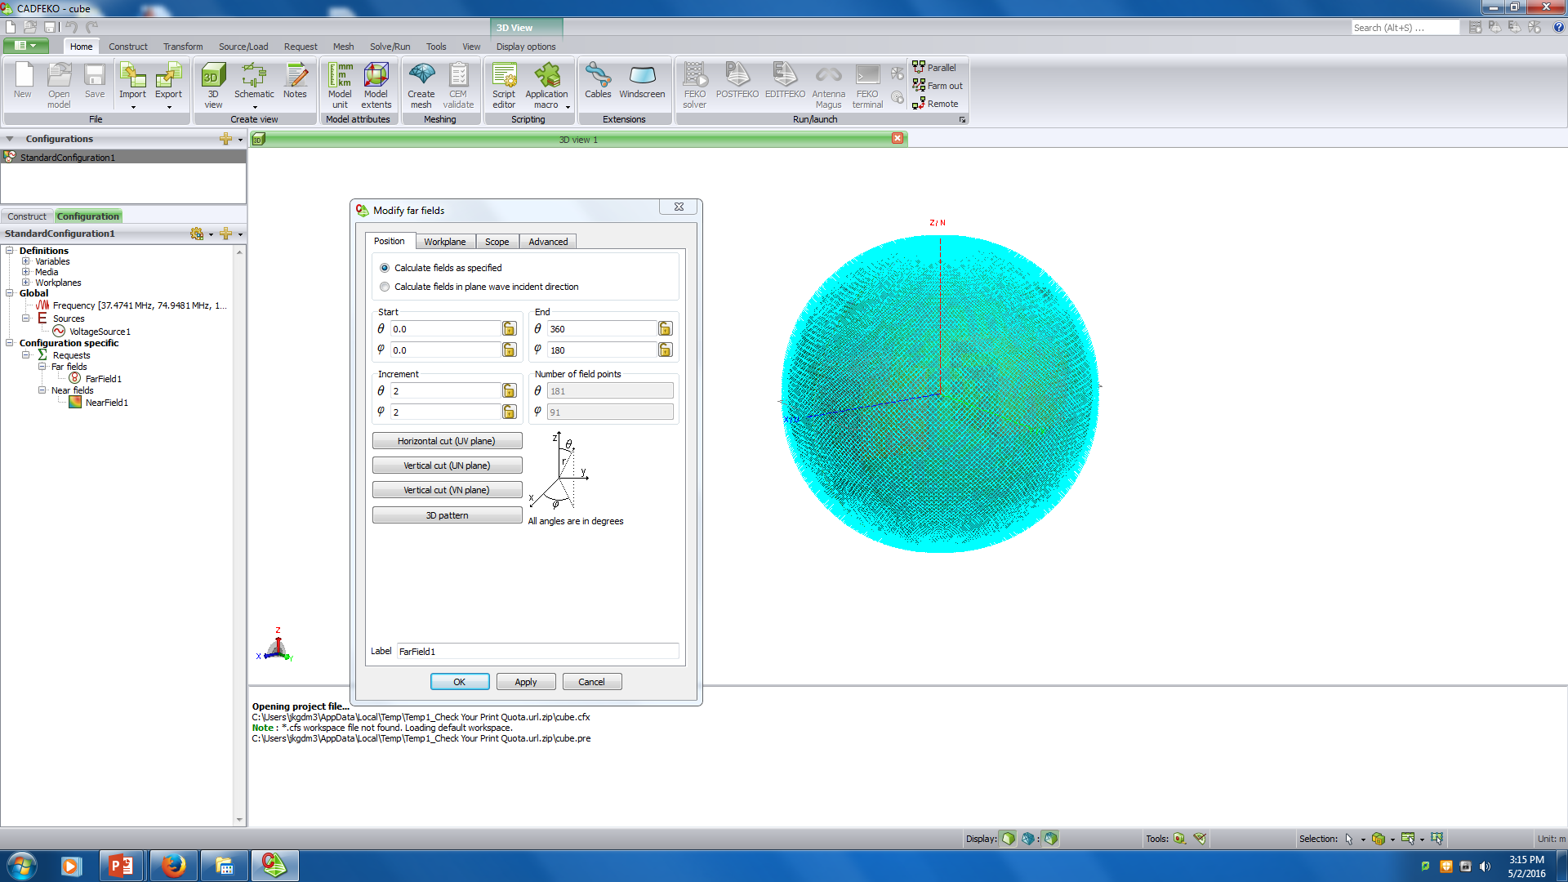
Far field adjustment:

Slide 6
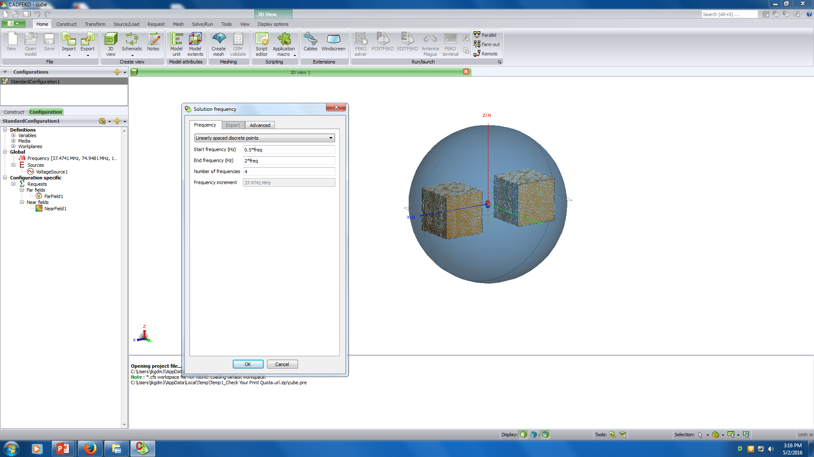
Frequency allocation for reflection coefficient:

Slide 7
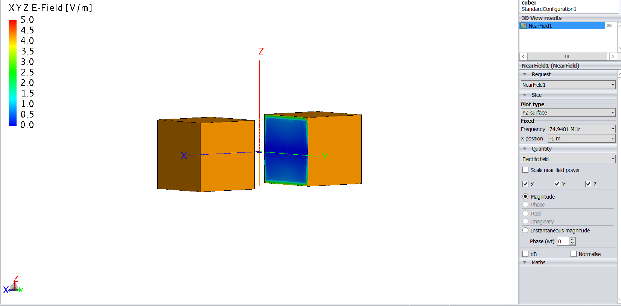
Near field variation with frequency:

Slide 8
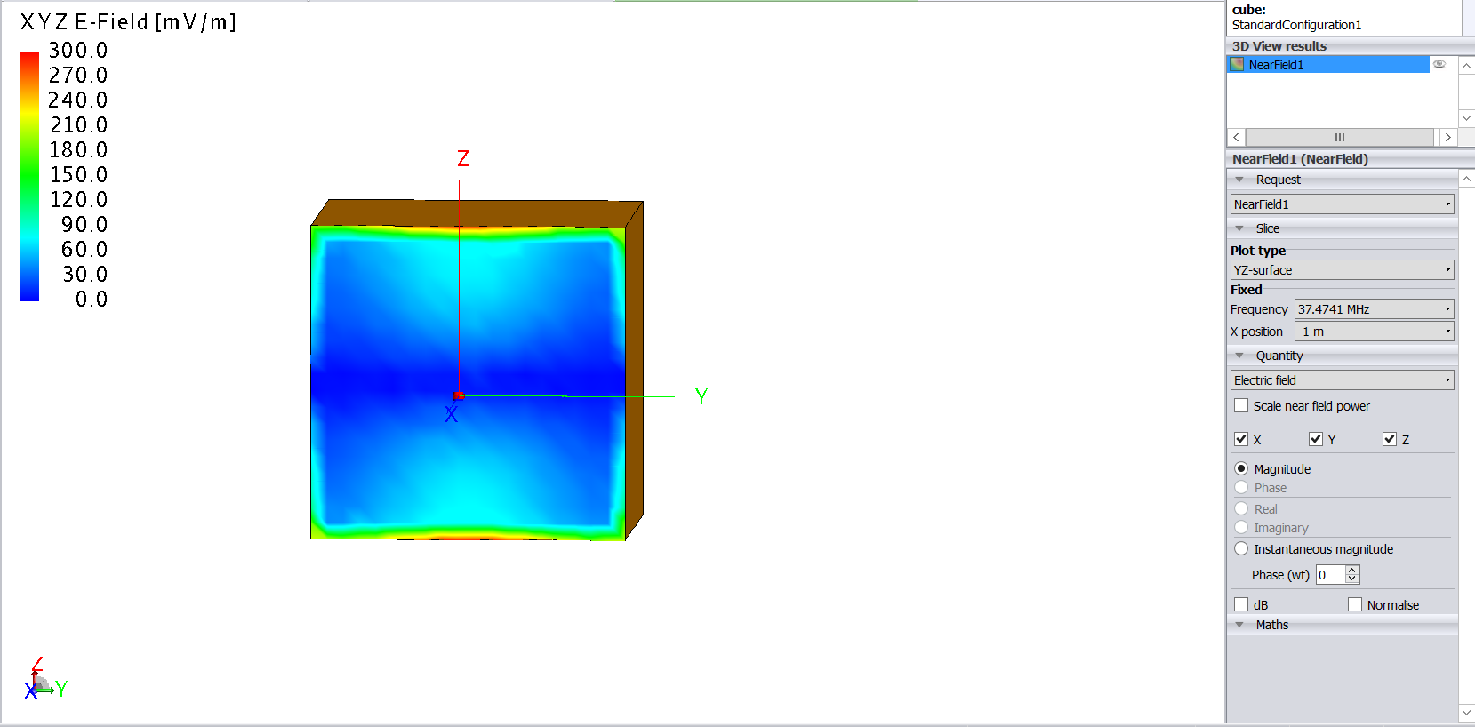
F1= 37.4741MHz

Slide 9
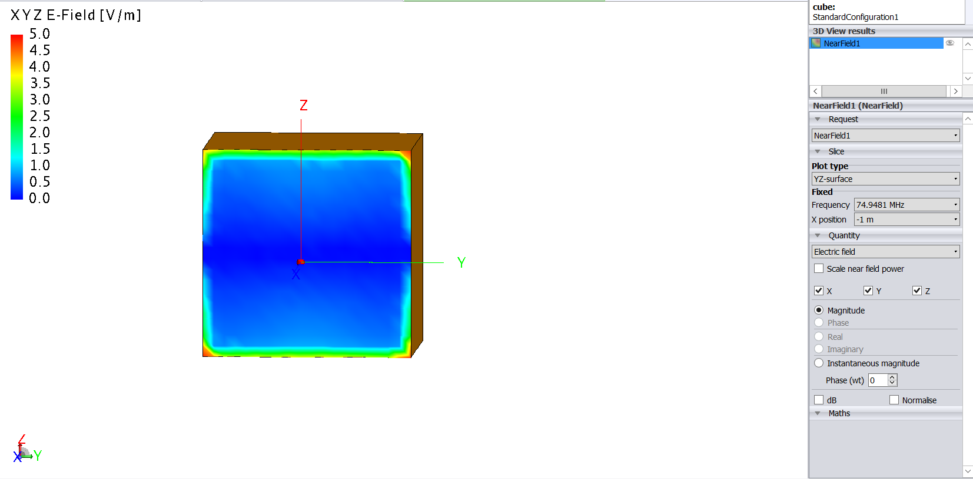
F2=74.9481 MHz

Slide 10
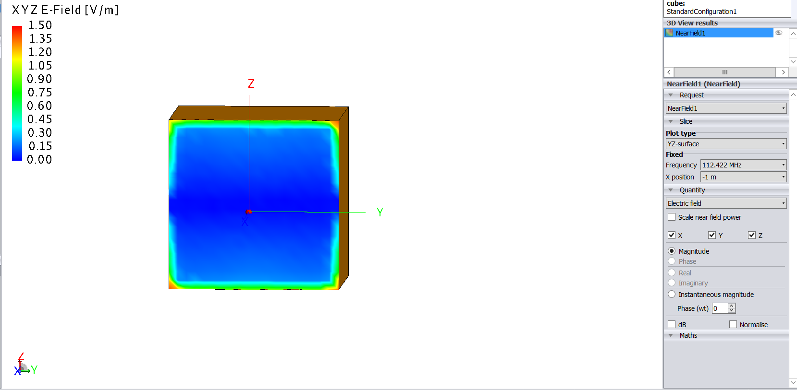
F3=122.422MHz

Slide 11
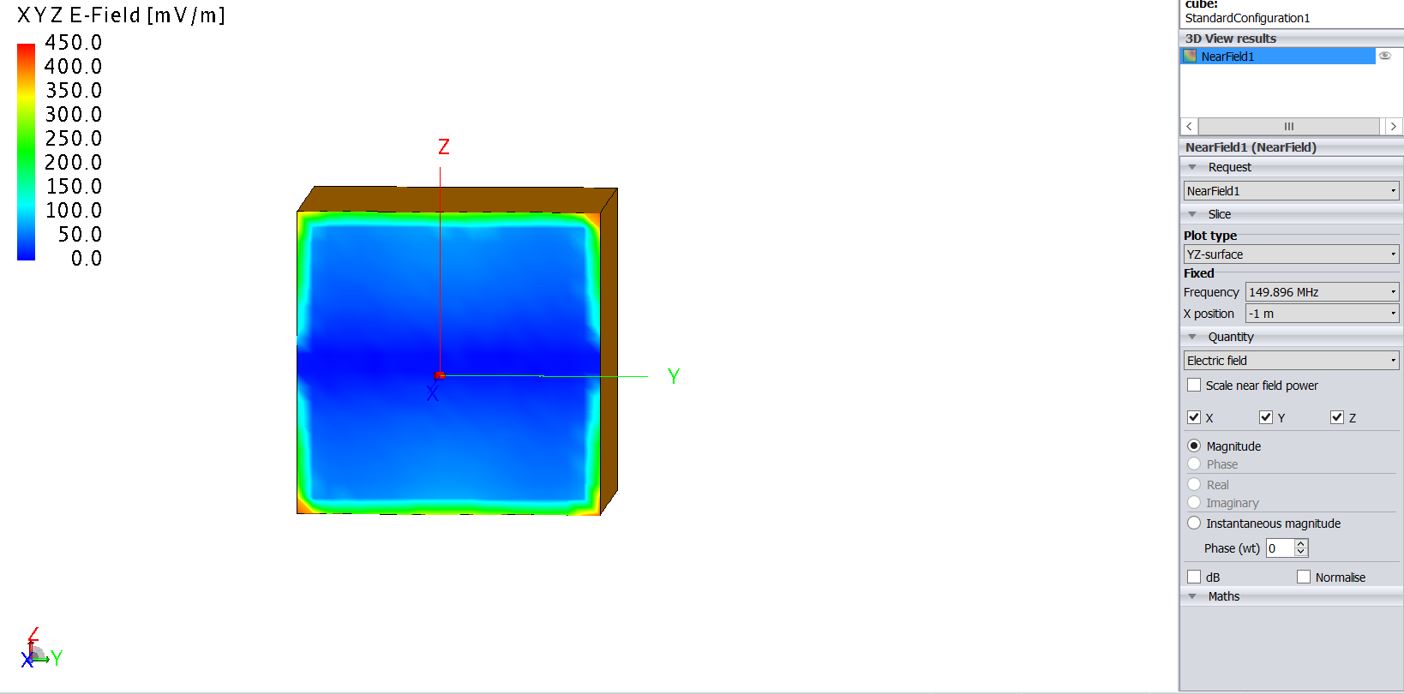
F4=149.896MHz

Slide 12
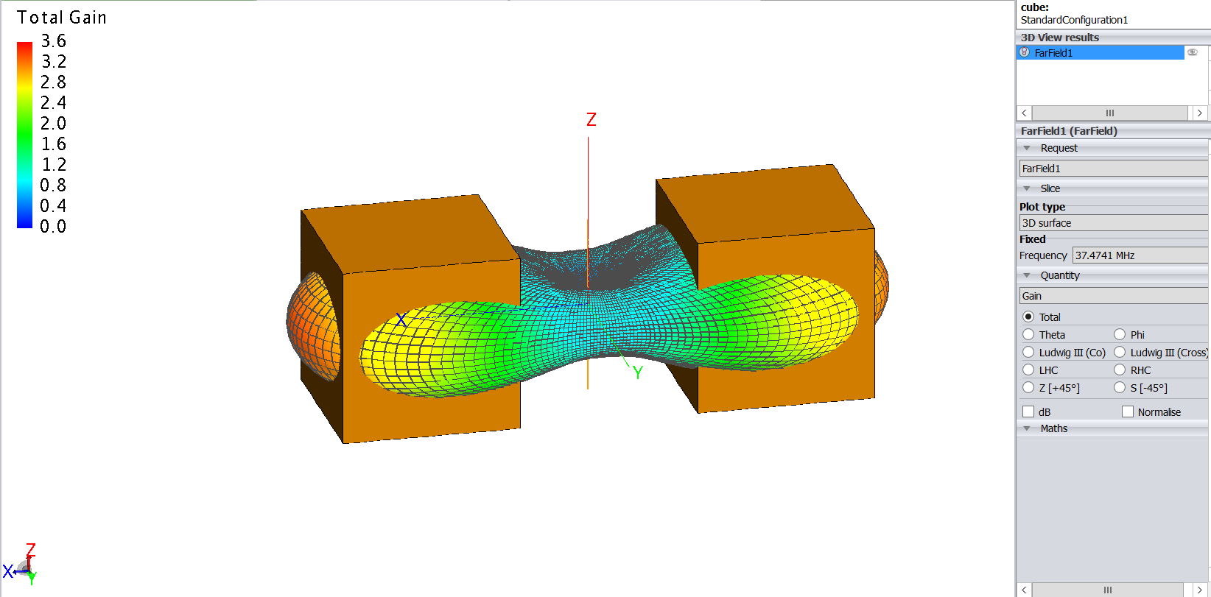
Far field variation with frequency: F1=37.4741 MHz

Slide 13
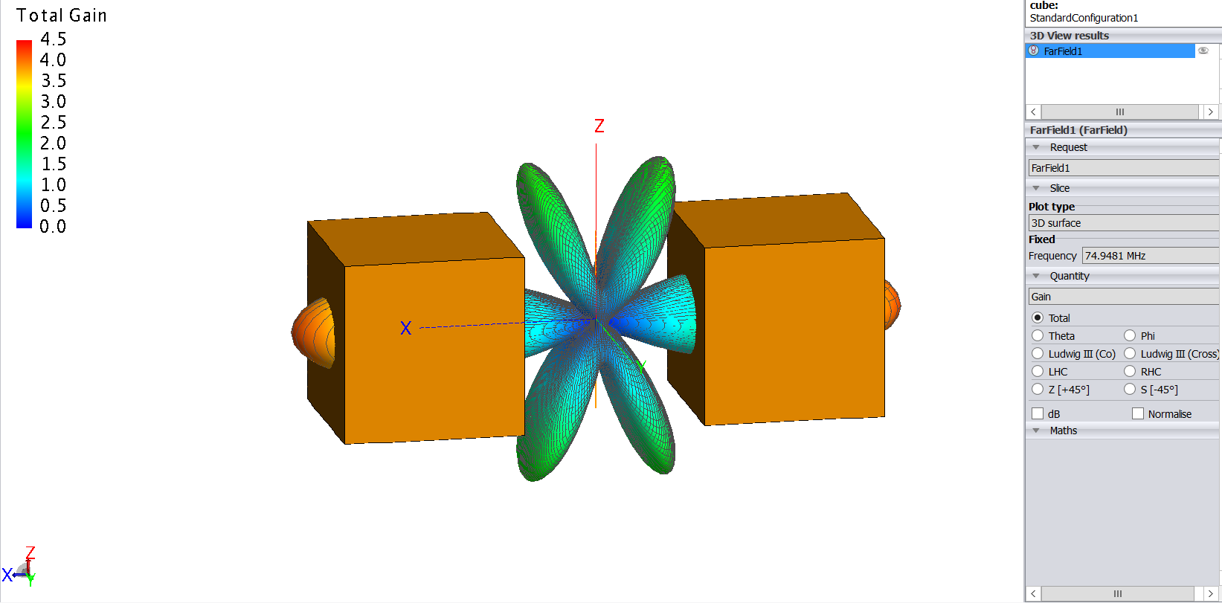
F2=74.9481 MHz

Slide 14
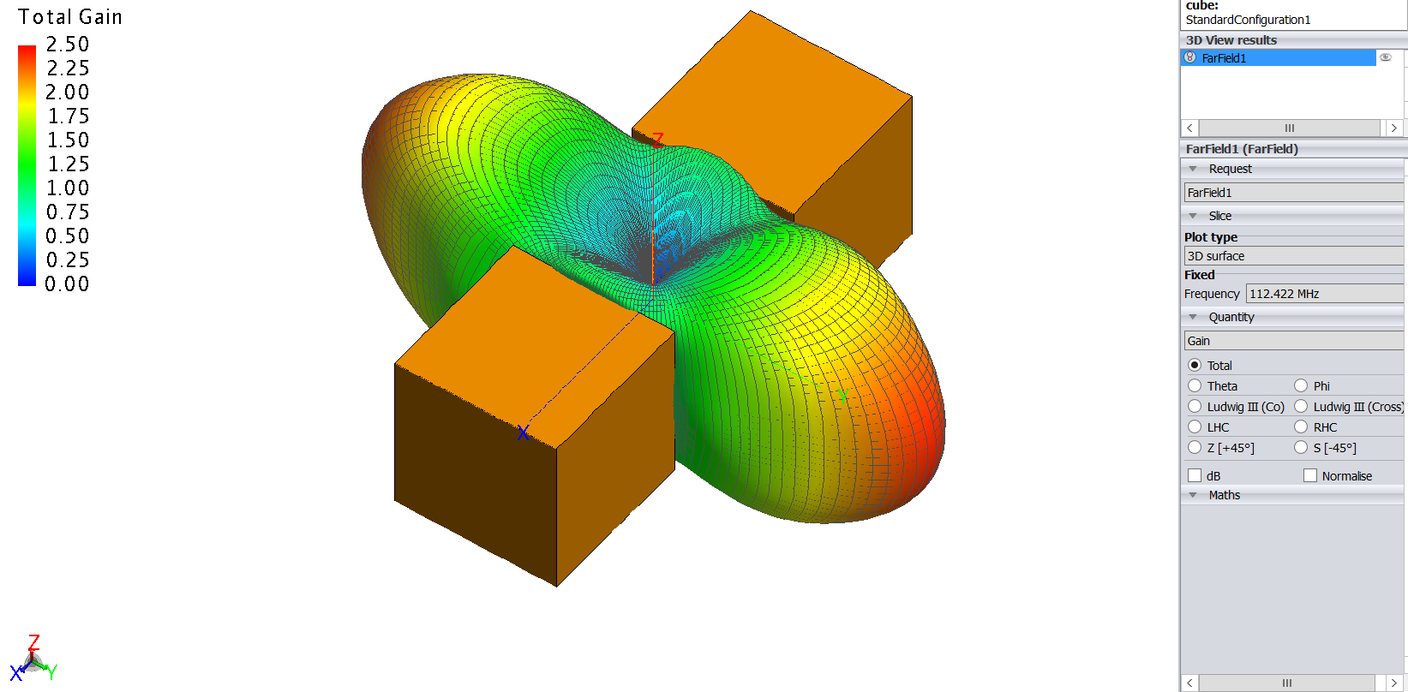
F3= 112.422 MHz

Slide 15
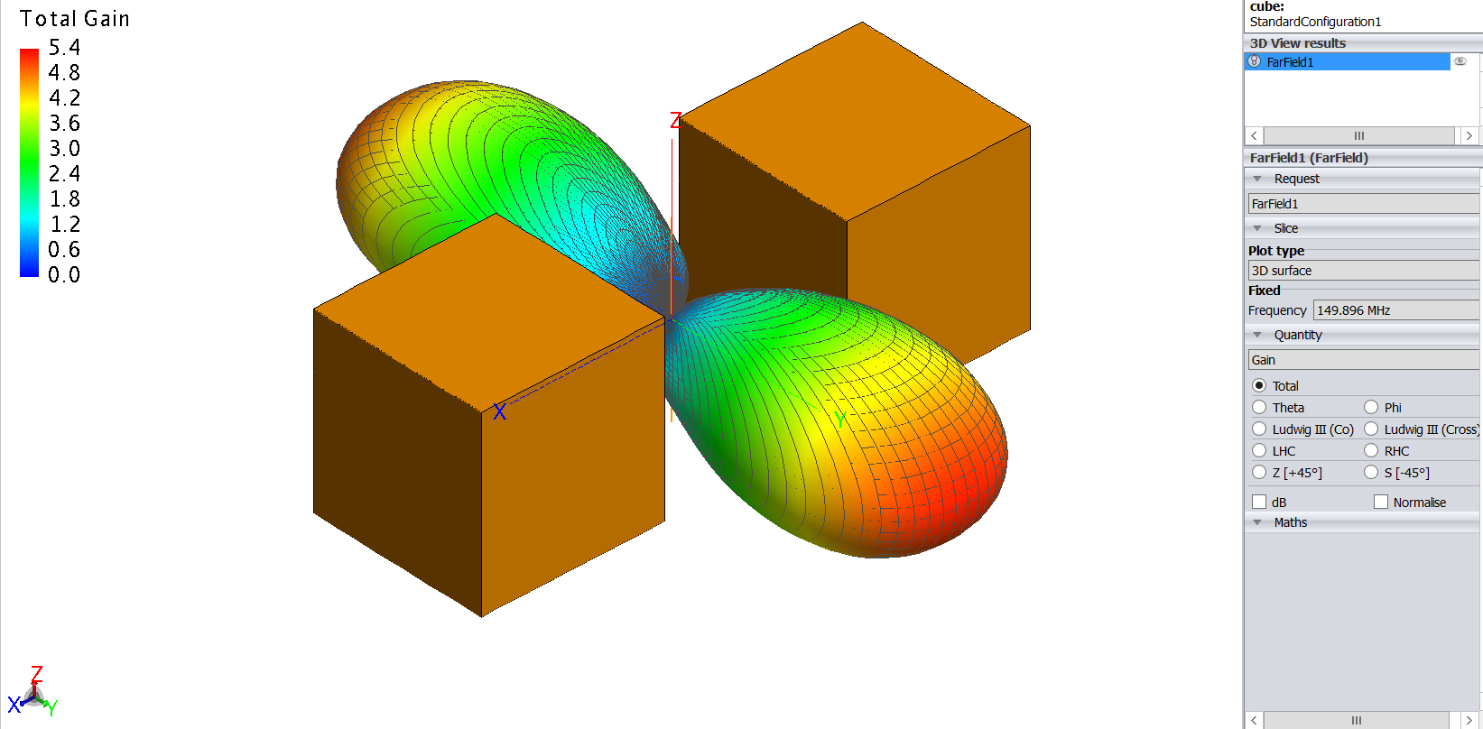
F4= 149.896 MHz

Slide 16
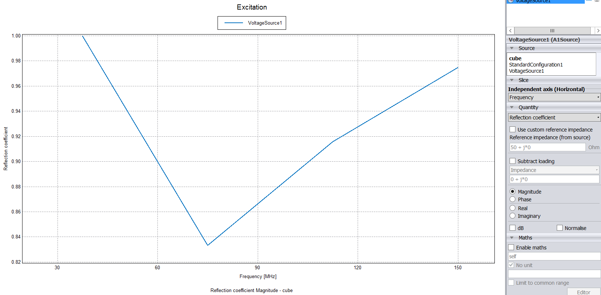
Reflection coefficient graph:

Slide 17
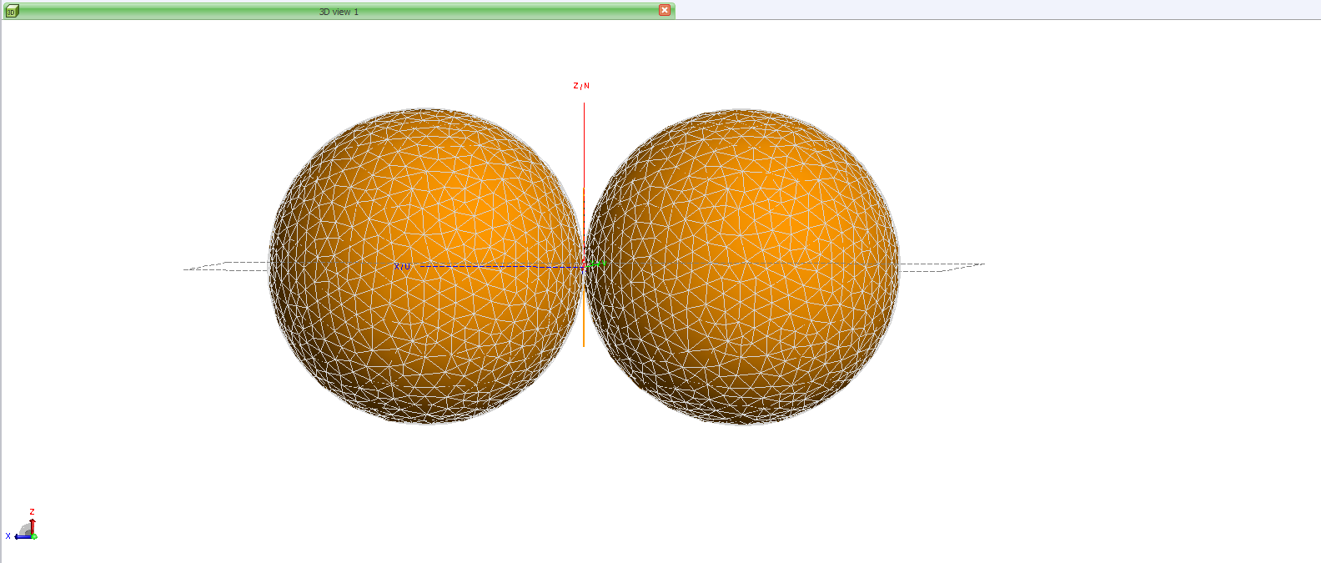
dipole in presence of two PEC sphere. when dipole is in middle. radius of sphere is lambda/2

Slide 18
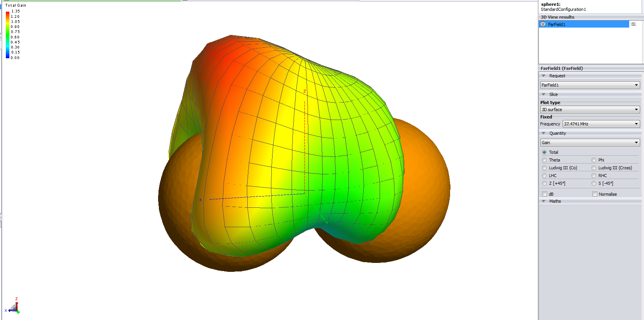
Far field variation with frequency: F1=37.4741 MHz

Slide 19
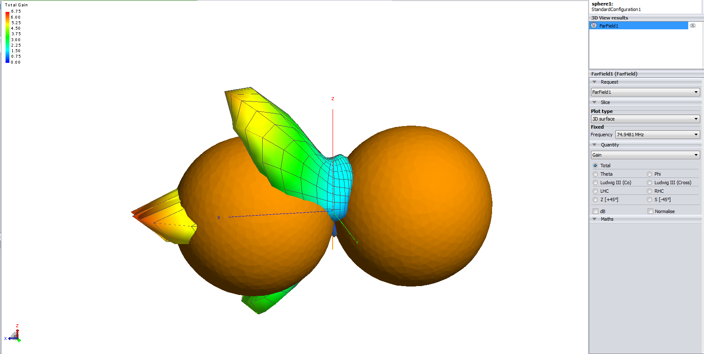
F2=74.9481 MHz

Slide 20
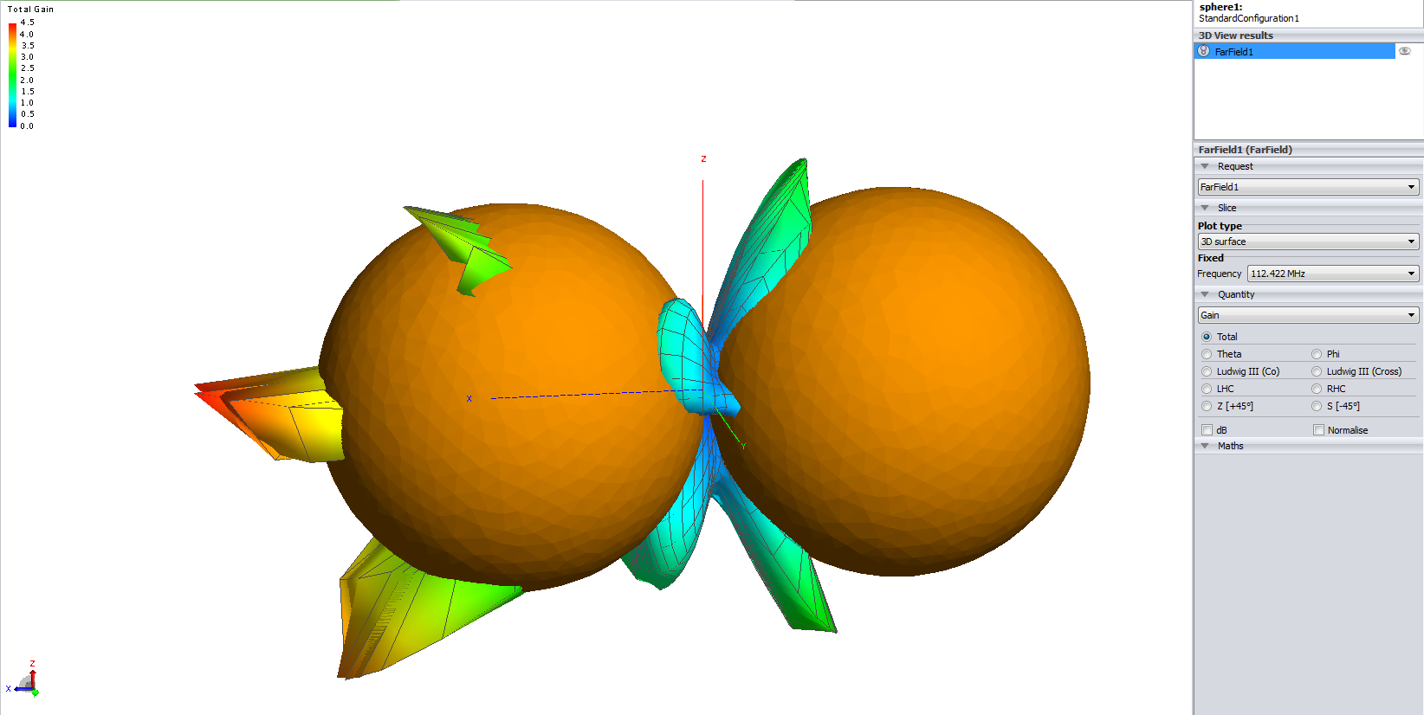
F3=112.422 MHz

Slide 21
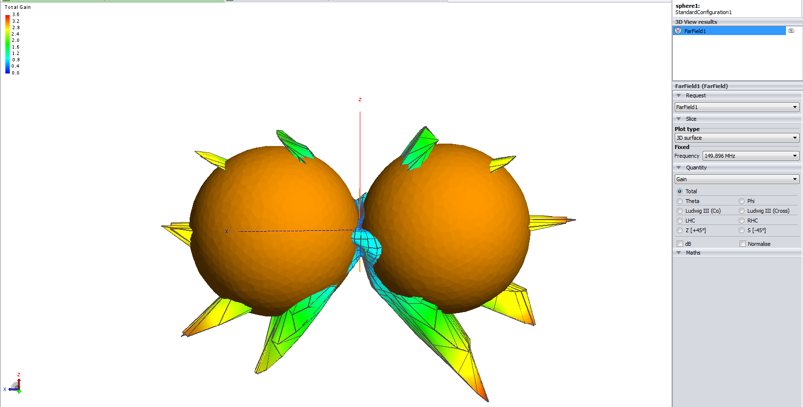
F4= 149.896 MHz

Slide 22
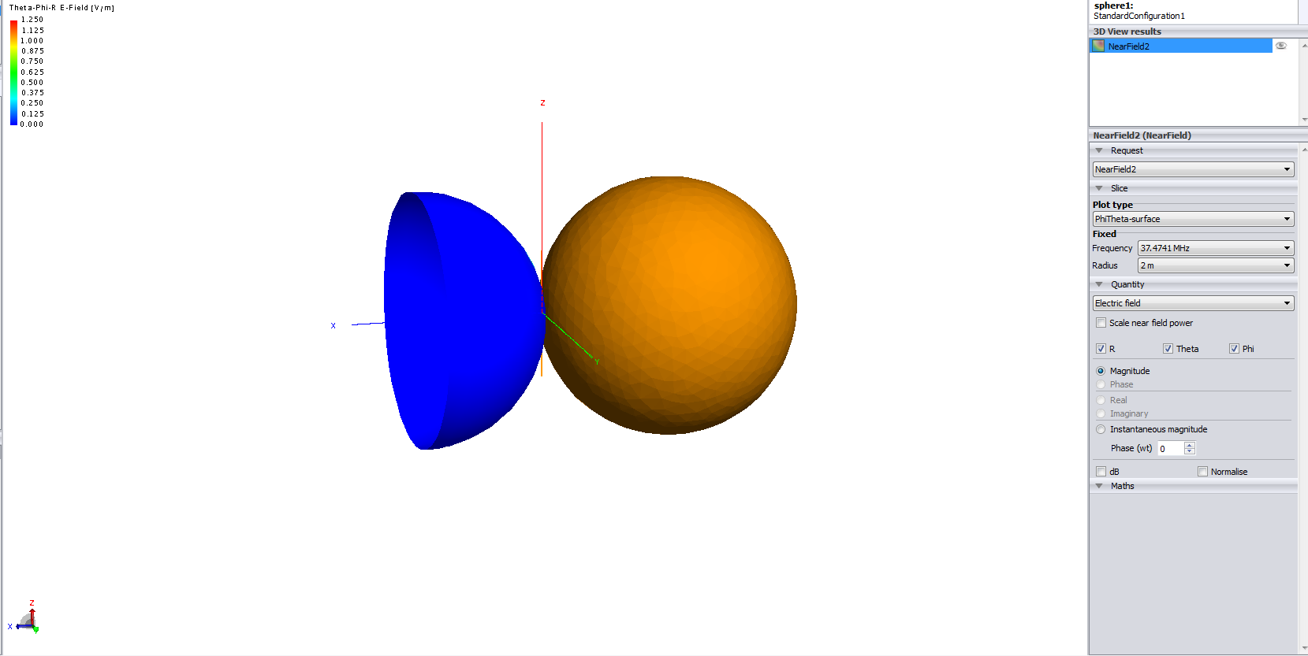
Near field variation with frequency(sphere 1):

Slide 23
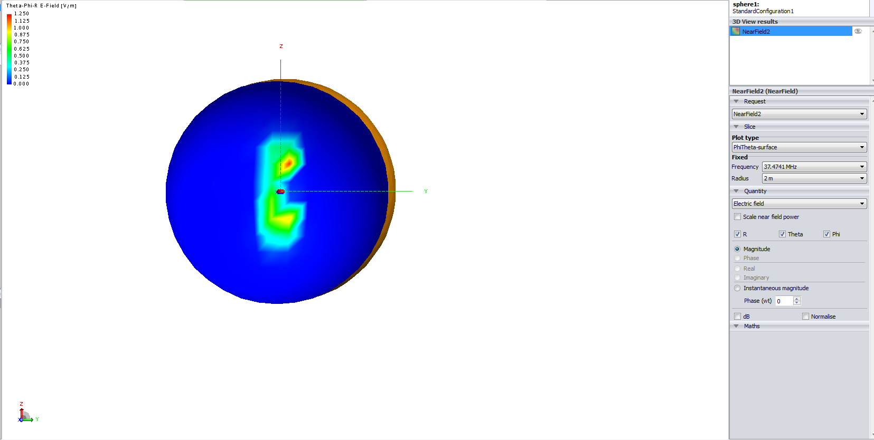
F1=37.4741 MHz

Slide 24

F2=74.9481 MHz

Slide 25

F3=112.422 MHz

Slide 26

F4= 149.896 MHz

Slide 27
Near field variation with second sphere

Slide 28
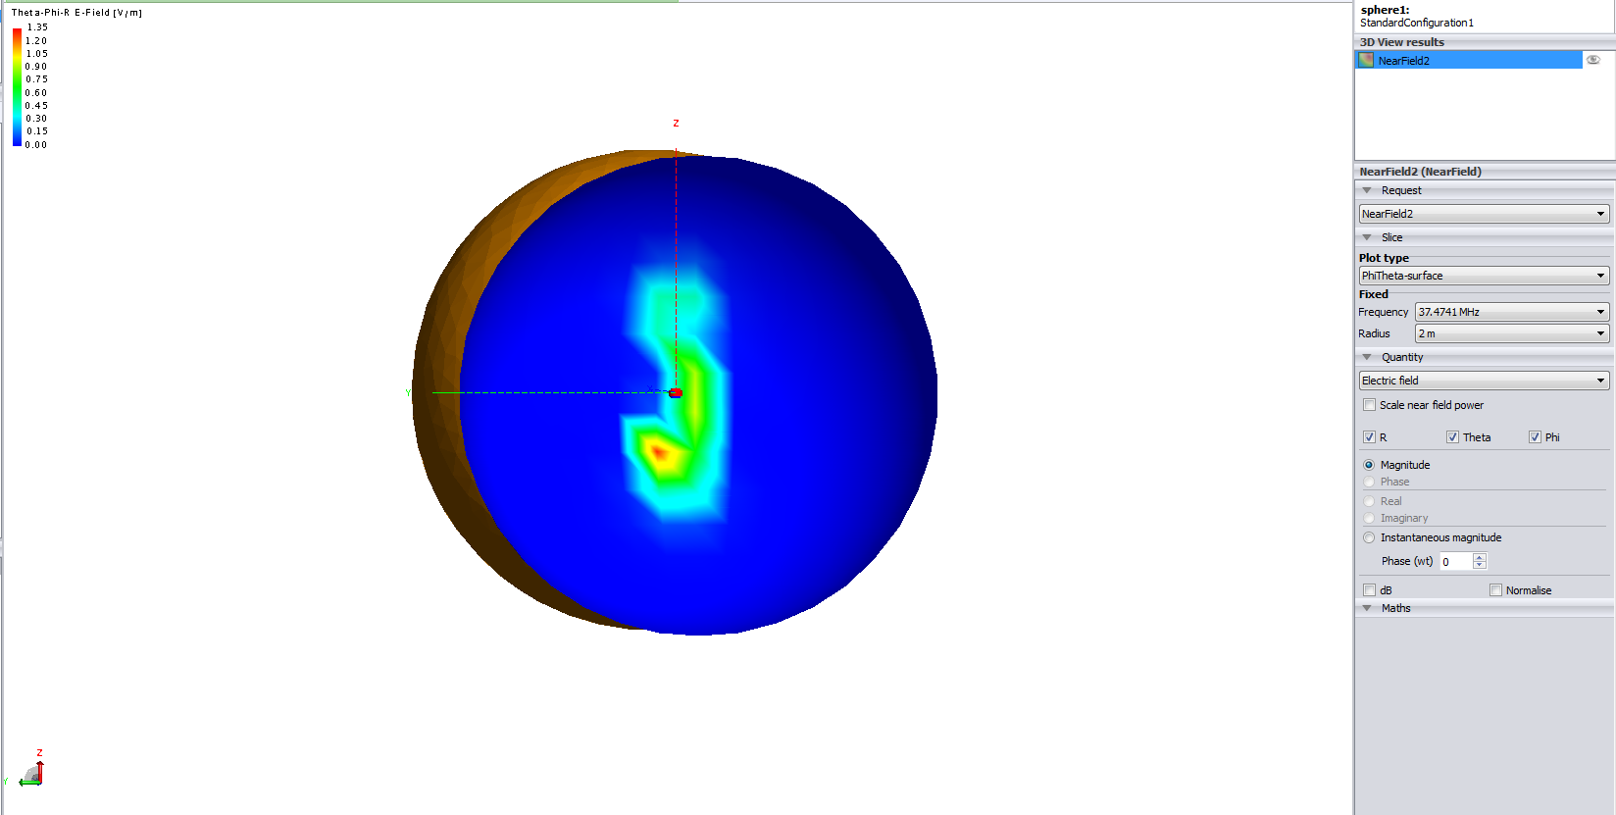
F1=37.4741 MHz

Slide 29
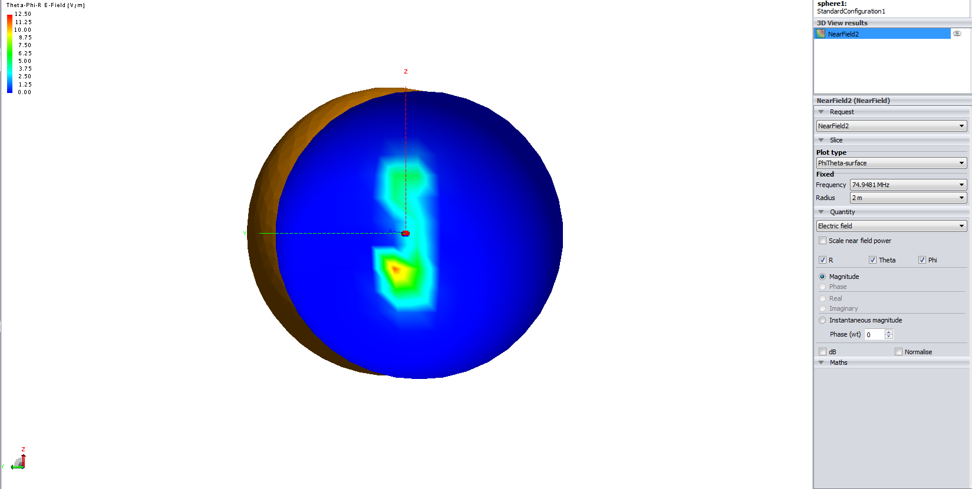
F2=74.9481 MHz

Slide 30
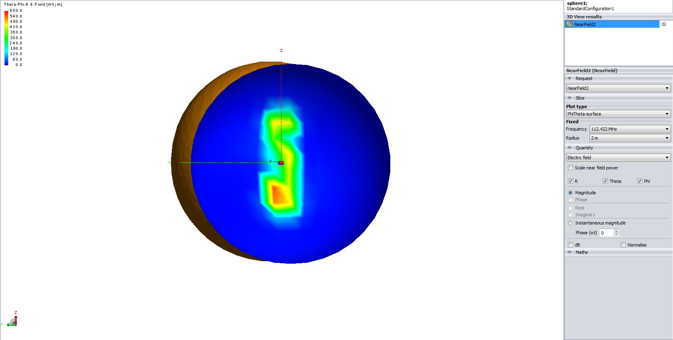
F3=112.422 MHz

Slide 31

F4= 149.896 MHz

Slide 32
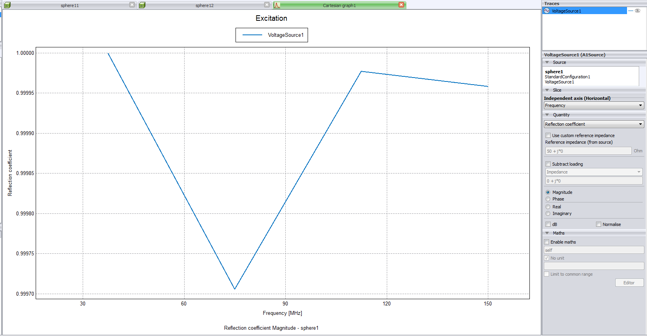
Reflection coeffiecient

Slide 33
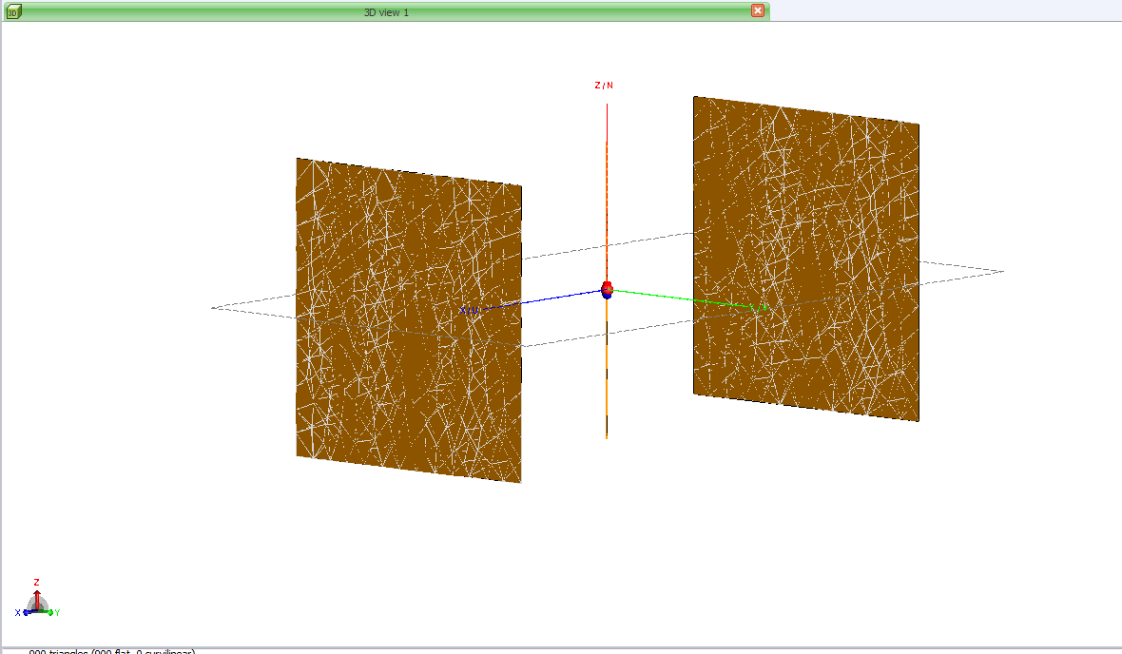
dipole in presence of two PEC plate. when dipole is in middle.size of plate lambda/2 x lambda/2:

Slide 34
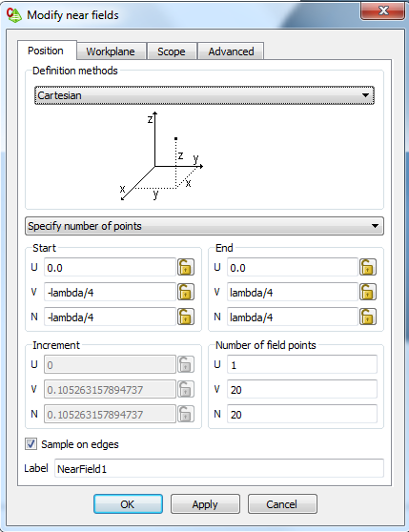
Near field coordinates:

Slide 35
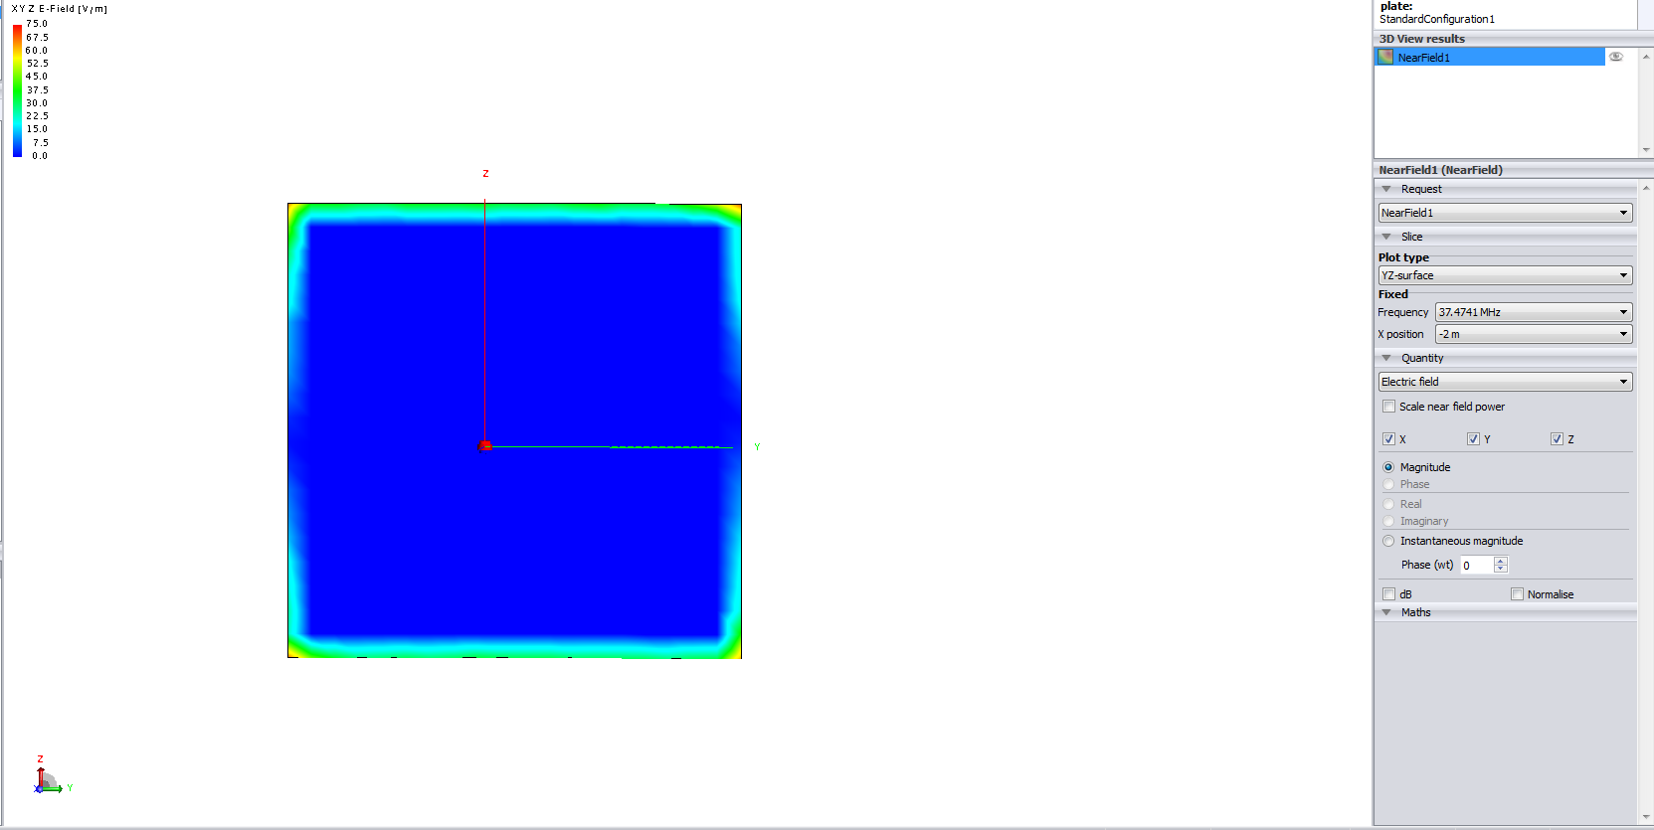
Near field variation with frequency: f1=37.471 MHz

Slide 36

F2= 74.981 MHz

Slide 37

F3= 112.422 MHz

Slide 38

F4=149.896 MHz

Slide 39
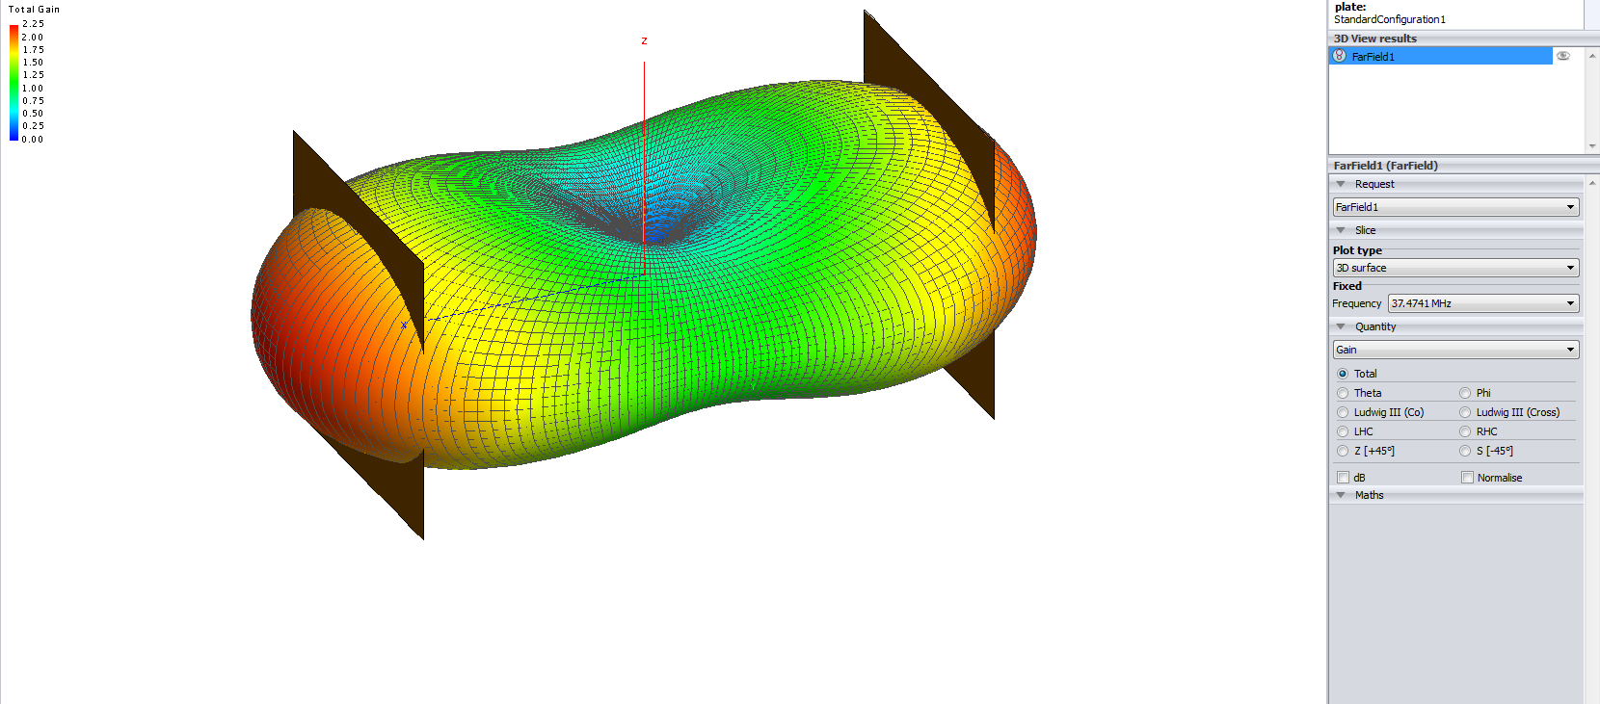
Far field variation with frequency: f1=37.471 MHz

Slide 40
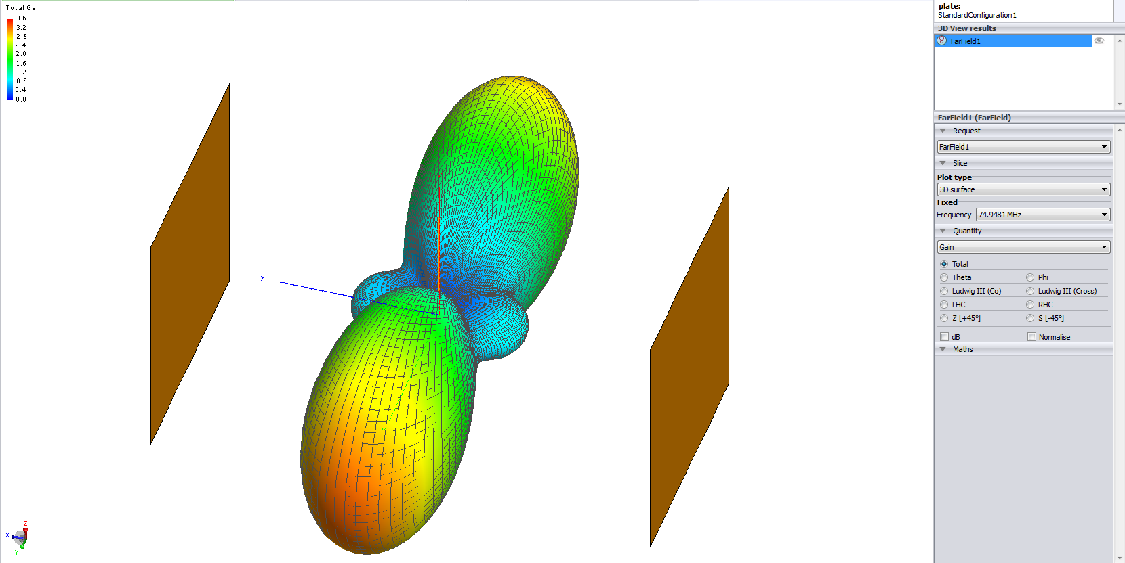
F2= 74.981 MHz

Slide 41
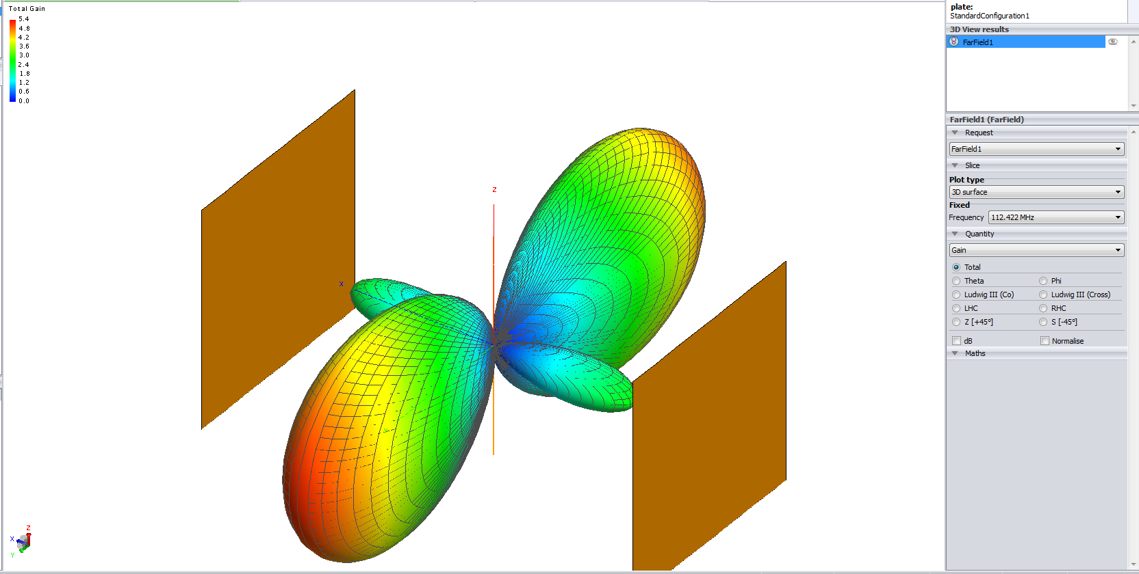
F3= 112.422 MHz

Slide 42
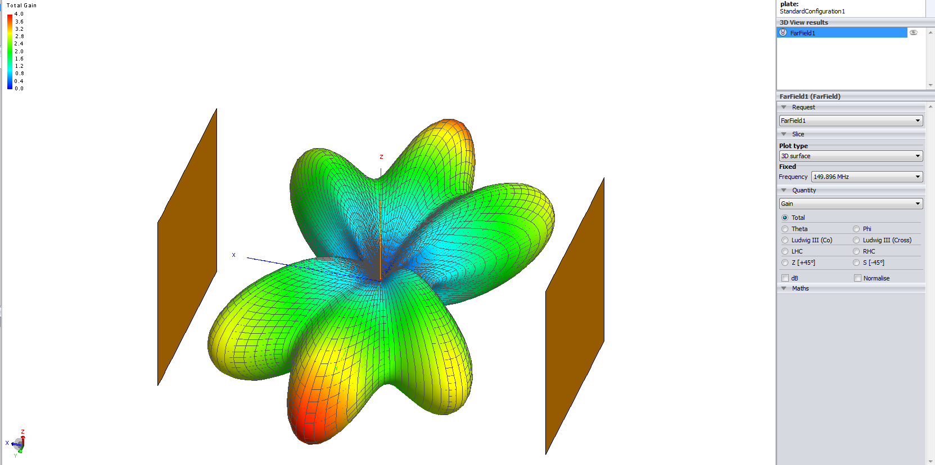
F4=149.896 MHz

Slide 43
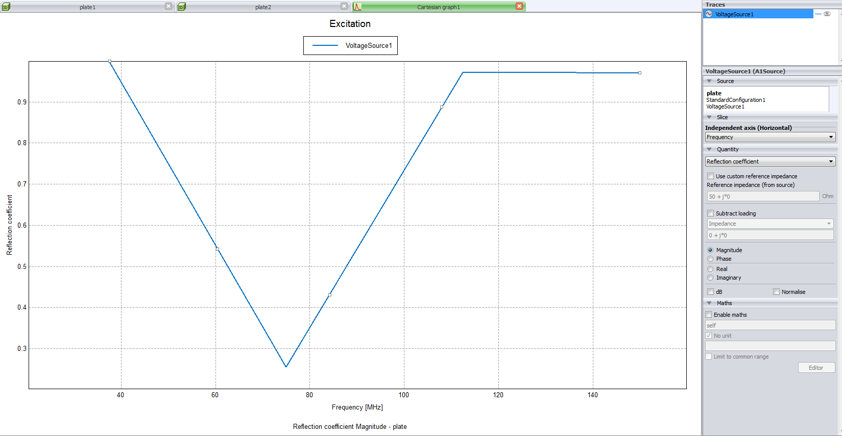
Reflection coefficient

